Slide 1
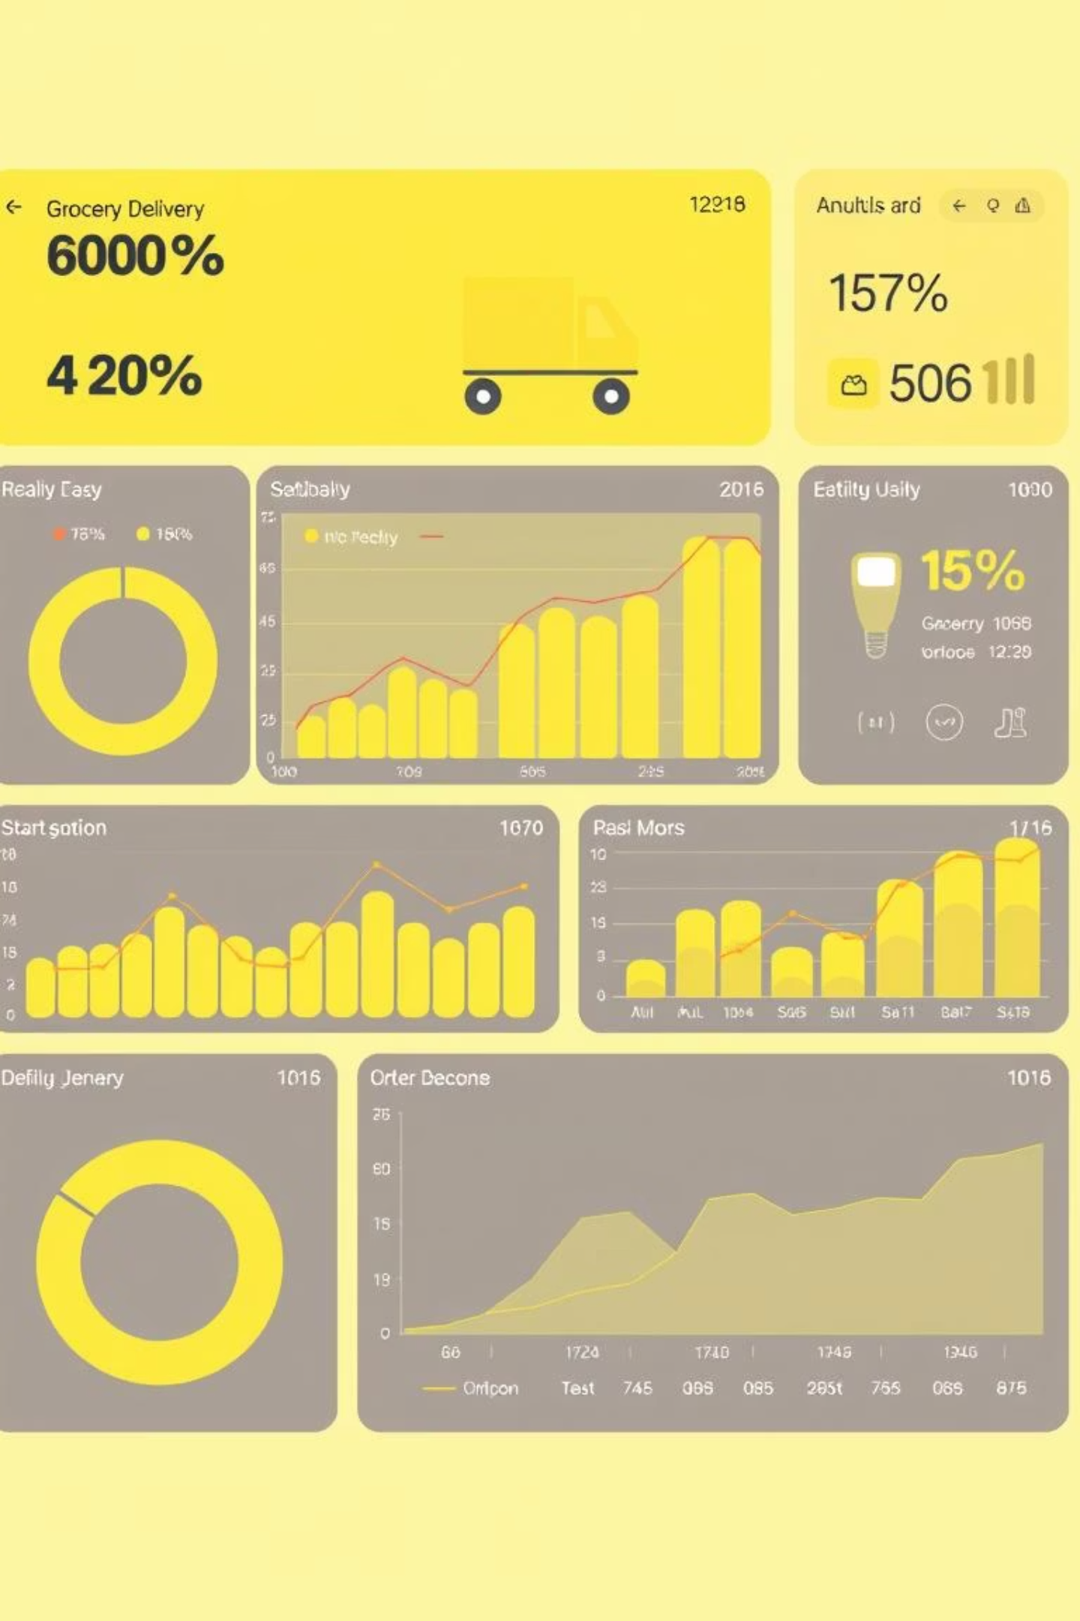
Blinkit Power BI Dashboard
An Analytical Report on Grocery Delivery Metrics

Slide 2
Dashboard Objectives
Sales Performance
Delivery Efficiency
Analyze product-wise sales to identify trends.
Track delivery times and pinpoint delays.
Customer Behavior
Product Insights
Understand new vs. returning customer patterns.
Identify top-selling and most-returned products.

Slide 3


Data Source & Tools
Data Source
Tools Used
BlinkIT Grocery Data (Excel format)
Microsoft Power BI Desktop

Slide 4
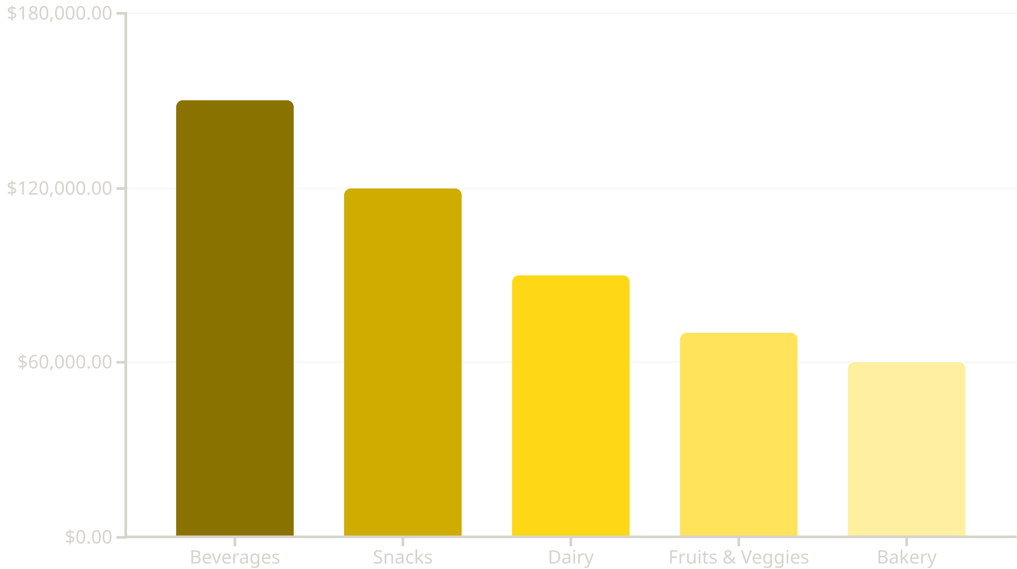
Sales by Category
This bar chart illustrates sales distribution across different product categories. Beverages and Snacks are the highest revenue drivers, indicating strong customer demand in these segments.

Slide 5
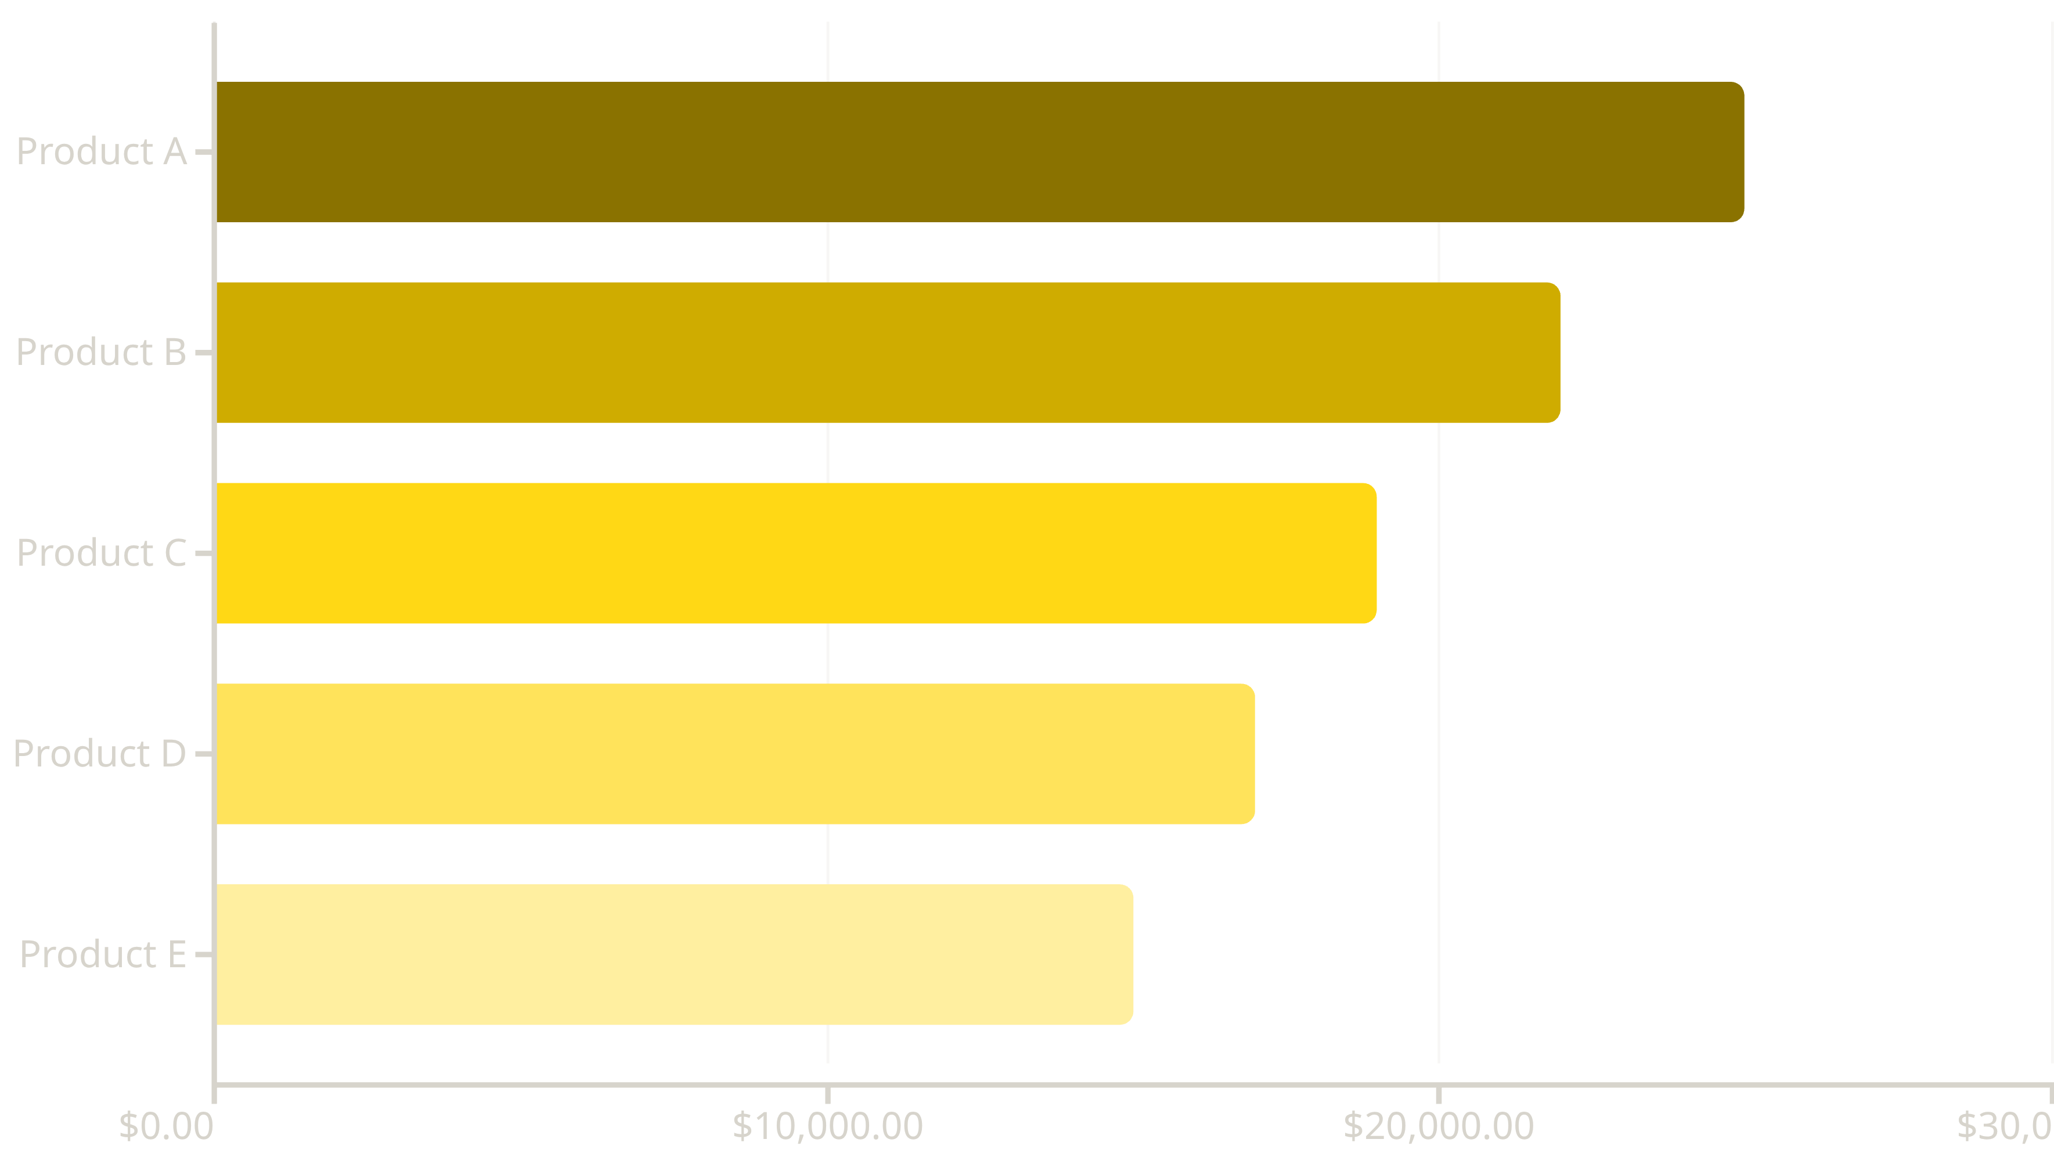
Top 10 Products by Sales
This chart highlights the top-performing products, providing insights into customer preferences and inventory management. Focusing on these items can optimize stock and marketing efforts.

Slide 6
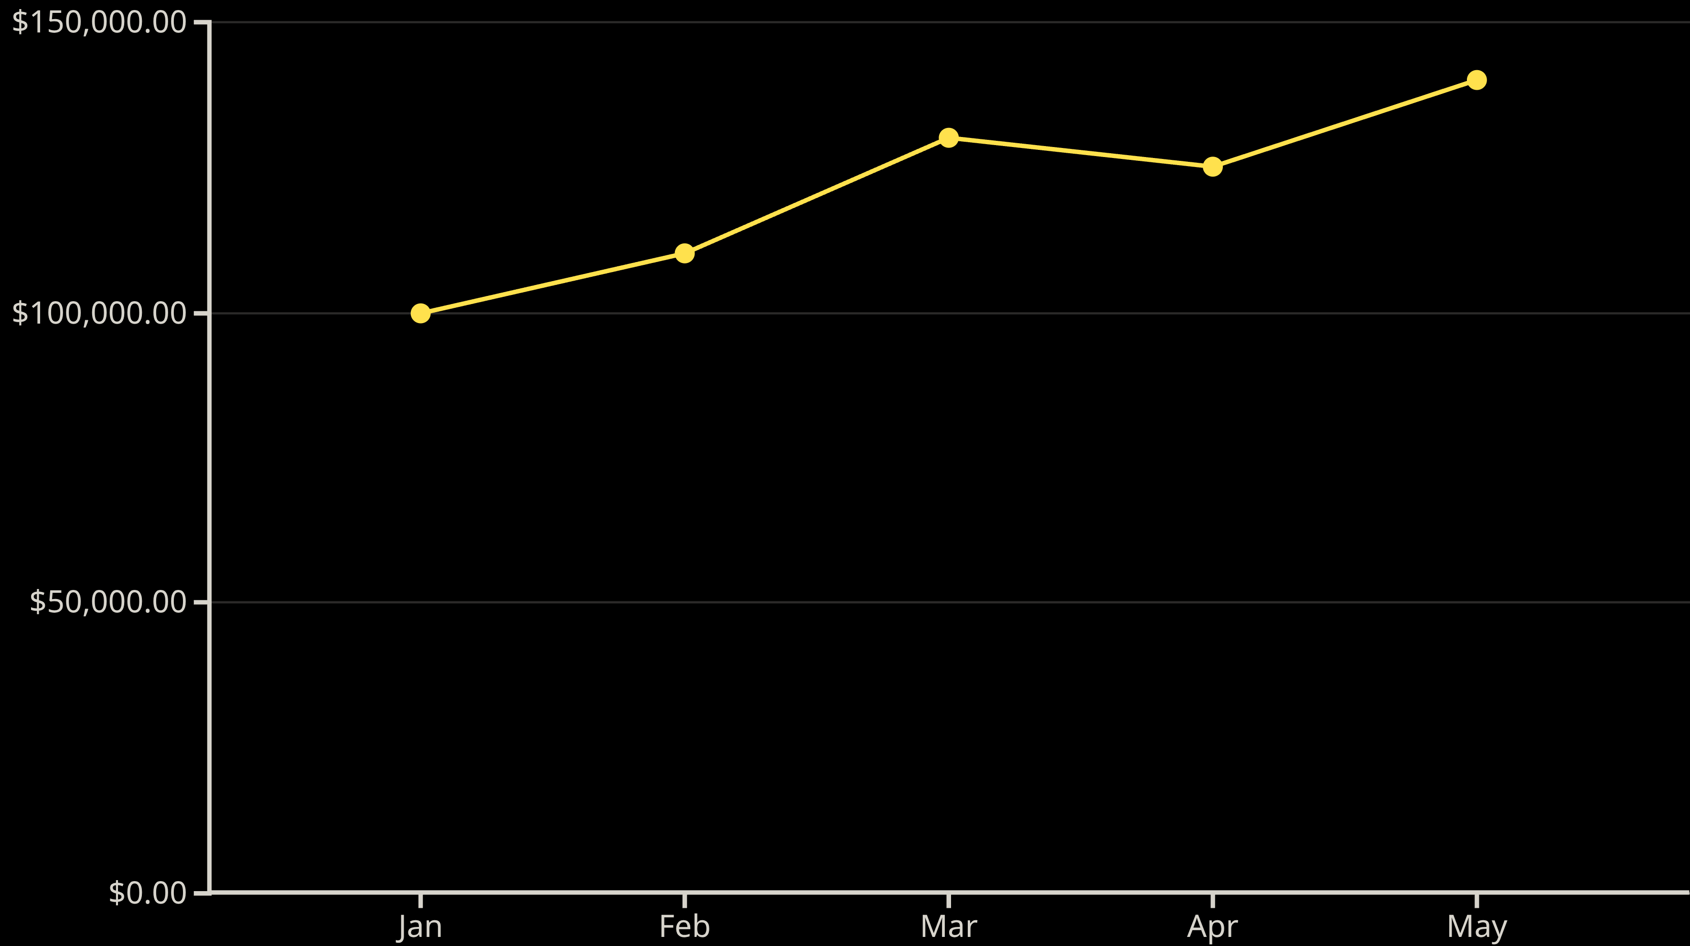
Sales Trend Over Time
This line chart visualizes sales performance over several months, revealing growth patterns and seasonal fluctuations. This trend analysis helps in forecasting and strategic planning.

Slide 7
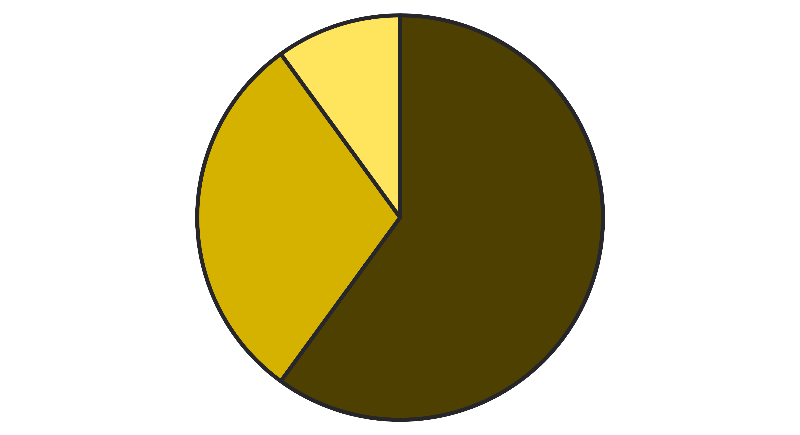
Delivery Time Distribution
< 15 min
15-30 min
> 30 min
This pie chart shows the distribution of delivery times. A significant portion of orders are delivered within 15 minutes, highlighting efficient operations, especially in metro areas.

Slide 8
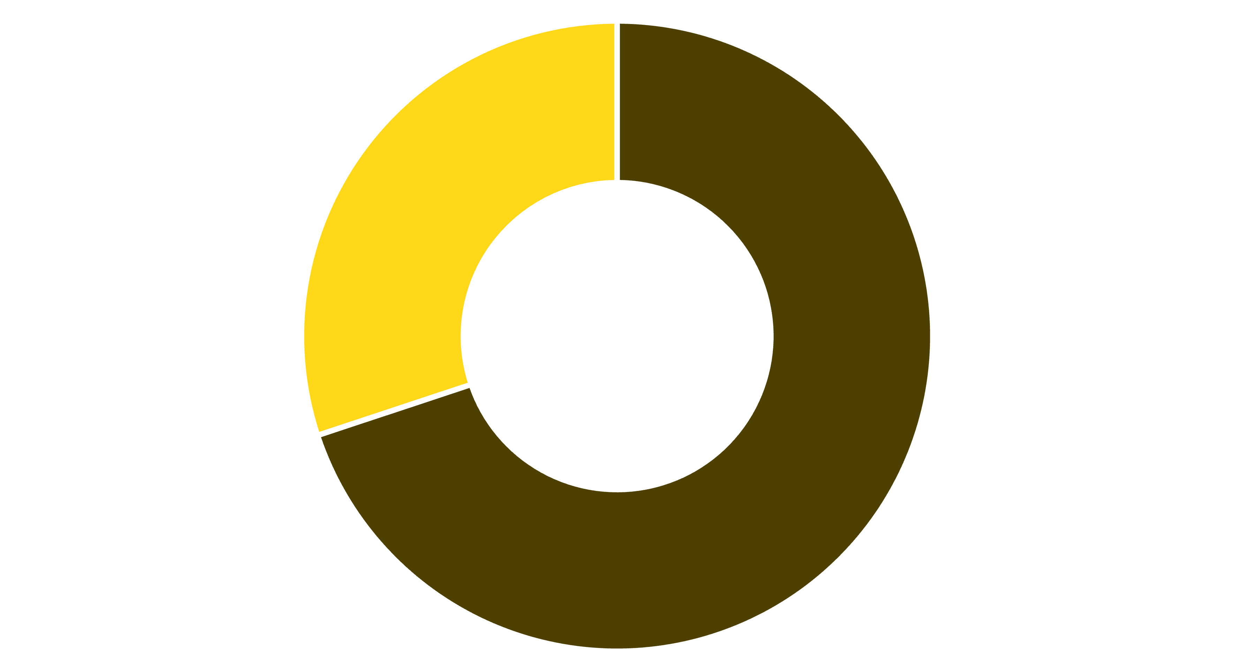
New vs. Returning Customers
Returning
New
This donut chart illustrates the ratio of new to returning customers. Strong retention among returning customers, particularly in urban areas, indicates effective customer loyalty strategies.

Slide 9

Average Order Value (AOV)
$25
Average Order Value
This KPI card displays the average value of each order, a key metric for revenue and profitability analysis.

Slide 10
Summary & Key Insights
High Return Rates
Revenue Drivers
Fruits & Veggies show high return rates, suggesting potential quality or delivery issues.
Beverages and Snacks significantly drive revenue, indicating strong market demand.
Fast Delivery
Customer Retention
Average delivery time is under 15 minutes in metros, a key competitive advantage.
Strong customer retention in urban areas highlights successful loyalty programs.

